Slide 1
Pour Control
Bar Management System
Notes:
Alanis

Slide 2
Overview
Bar management web application
Helps with tracking ingredient stock and usage
Poor management can result in lack of ingredients or overstocking, difficulty managing menu changes
Pour Control allows users to manage inventory, menu items, and calculate ingredient requirements
Notes:
Alanis

Slide 3




Our Team
Kian Delamarre
Front end / Middle
Alexandra Danciu
Middle
Ahmed Ewas
Middle
Alanis Ballans
Back end
Notes:
Each of us introduce ourselves

Slide 4
Features
View inventory list
Updated quantities in the inventory
View Menu
Add drinks to menu
  Auto add ingredients for drink
  Add recipe
  Cocktail browser
Delete drink from menu
Calculate ingredient amounts to fulfill menu per week
View recipes for menu drinks
Notes:
Alanis

Slide 5
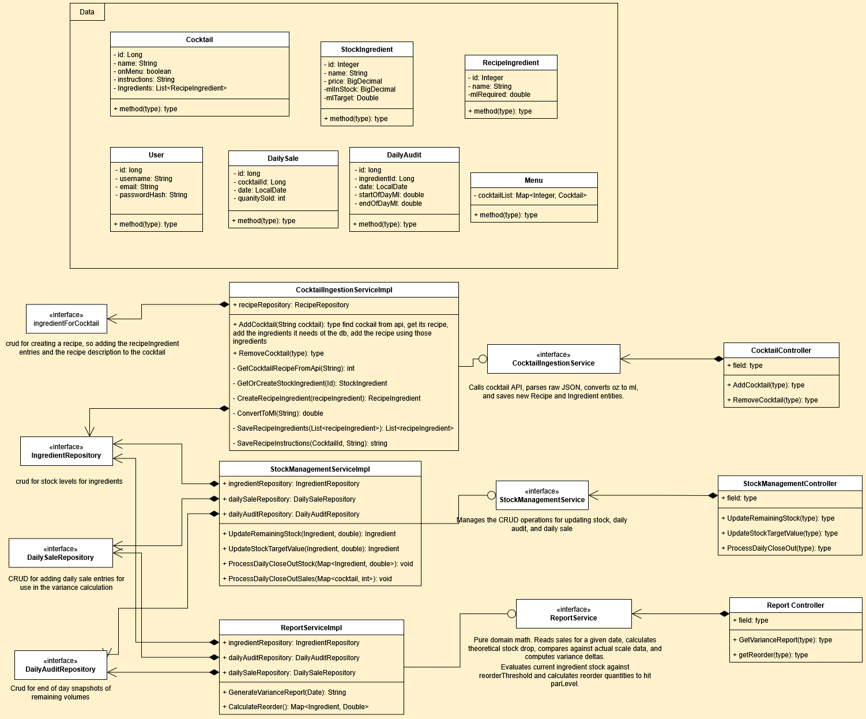
System Organisation
UML Diagram
Notes:
Alexandra
This slide shows the overall class diagram for our bar management system.
It illustrates how our main data classes, services, repositories, and controllers work together to manage cocktail recipes, ingredient stock levels, daily sales, and reporting.
The controllers handle the HTTP requests from the frontend.
The service layer handles the business logic and the API calls.
The repositories handle reading and writing to the database.
### DTOs ###
Starting at the top, we have our data classes, which represent the main entities in our system.
The Cocktail class stores information about each cocktail, including its name, its recipe and the ingredients required to make it.
The StockIngredient class represents the ingredients we hold in stock. This allows us to monitor inventory and identify when ingredients need to be reordered.
We also have the RecipeIngredient class, which connects cocktails to their ingredients and stores the minimum required quantity for each ingredient in a recipe.
The DailySale class records the number of cocktails sold on a particular date, while the DailyAudit class records the opening and closing stock levels of ingredients.
These two classes are particularly important for calculating stock usage and generating daily reports.
Finally, the Menu class holds the cocktails currently available on the menu.
### Cocktail ###
Moving down to the cocktail section, this is where we handle adding and removing cocktails from our menu.
The CocktailServiceImpl is responsible for retrieving information from an external API.
When a cocktail is added, the service calls the API, parses the returned JSON data, and converts the information into our own Java objects.
It identifies the ingredients required for the cocktail, checks whether those ingredients already exist in our database, and creates any missing ingredient records.
Next, it creates the recipe entrie and saves the cocktail's instructions.
### Stock Management ###
Next, we have the stock management section, which is one of the most important parts of the system.
The StockServiceImpl handles the main operations relating to ingredient inventory.
It allows us to update the remaining quantity of an ingredient and change its target stock level. This helps us keep inventory information accurate and maintain appropriate stock levels.
The service also processes daily sales and stock audits.
### Reporting ###
Finally, we have the reporting section.
The ReportServiceImpl uses the ingredient, daily sale, and daily audit repositories to generate reports based on the data collected by the system.
One of its main functions is generating a variance report for a specific date.
The service calculates the expected ingredient consumption based on the cocktails sold and their recipes, then compares this with the stock information recorded in the daily audits.
This allows us to identify differences between expected and actual stock consumption.
The reporting service also calculates reorder quantities by comparing the current stock levels with the minimum and target stock levels defined for each ingredient.

Slide 6
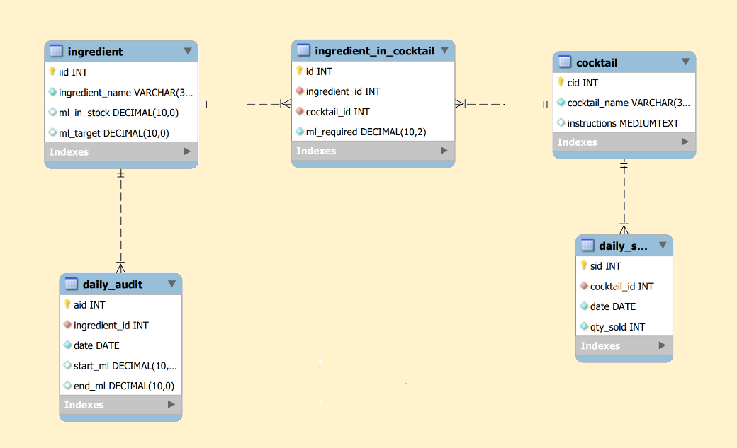
System Organisation
ERD
Notes:
Alanis

Slide 7

External API: Spoonacular
Flow:
Search: drink name → recipe ID
Fetch: ingredients, amounts, instructions
Convert: units → millilitres
Save: cocktail, ingredients and recipe amounts
Notes:
Alanis

Slide 8

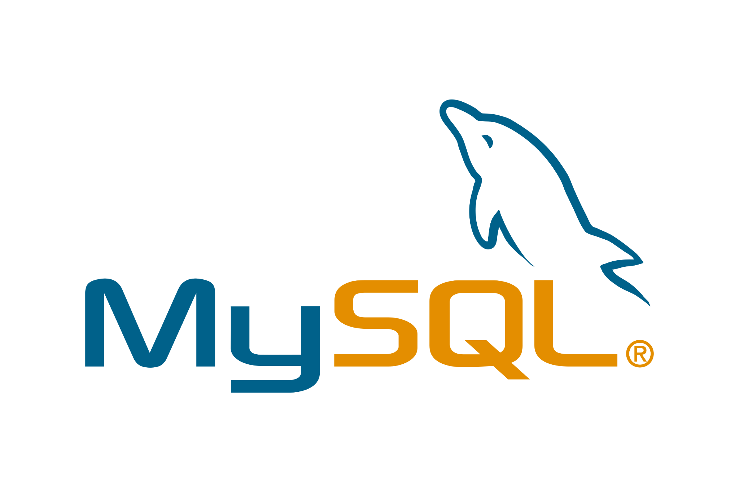


Technology Stack
Spring DI
Spring Boot
REST Template
MySQL
JPA
React
Notes:
Ahmed

Slide 9
Next: Demonstration
Notes:
Kian

Slide 10
Lessons Learned
Naming conventions
Planning
  Deciding java version
  Which API to use
Error handling
Connecting tech stack
Notes:
Ahmed

Slide 11
Future work
User authentication
Access permissions
Ingredient/cocktail costs
Export recipe sheet of menu items
Notes:
Ahmed

Slide 12
Questions
Notes:
Kian

